Slide 1
Working with Python in Visual Studio 2019
Tyreke White
Program Manager, Python Developer Tools

Slide 2
What’s New for Python in Visual Studio 2019?
Open Folder Support

Slide 3
What’s New for Python in Visual Studio 2019?
Python Toolbar

Slide 4
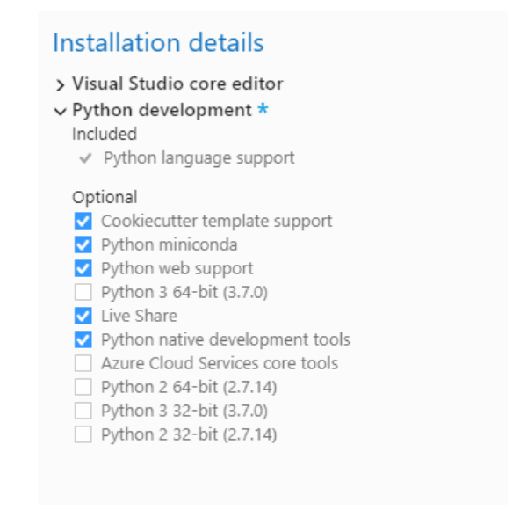
What’s New for Python in Visual Studio 2019?
What’s New for Python in Visual Studio 2019?
Miniconda included with VS Installer

Slide 5
What’s New for Python in Visual Studio 2019?
Live Share Support for Python

Slide 6
Demo: Open Folder Support Python Toolbar

Slide 7
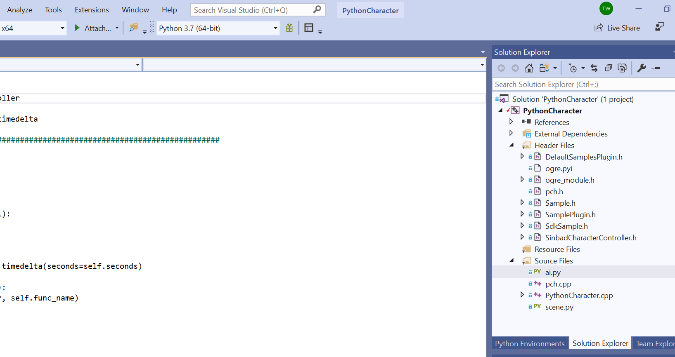
Embedded Python Project

Slide 8
Demo: Conda Environments

Slide 9
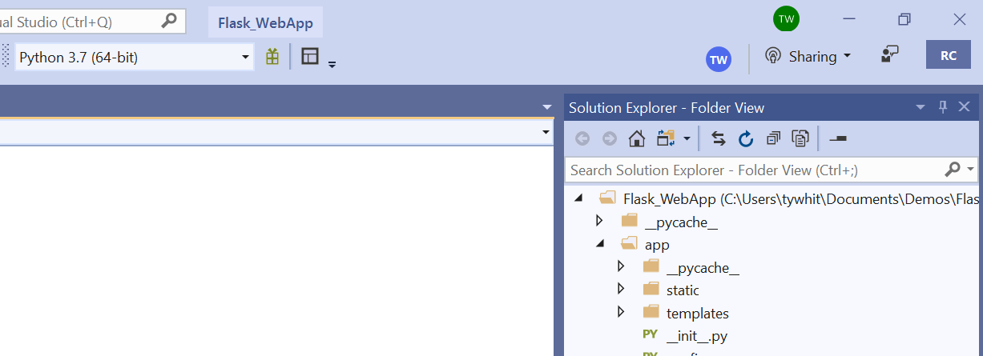
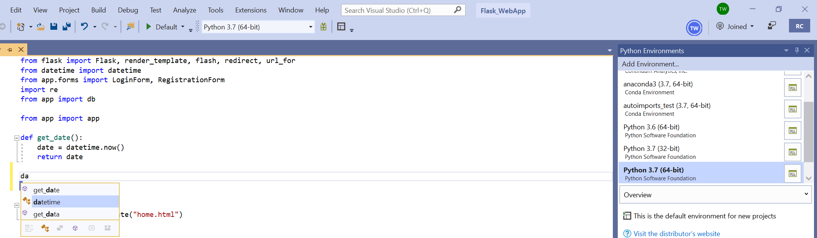
Live Share Support for Python
Share Editors
Intellisense Support
Collaboratively Code and Debug

Slide 10
Ready to Get Started?
aka.ms/pythonvs
for info and downloads
aka.ms/pythonblog
for the latest info on all things Python in VS

